Slide 1
Software Architecture
Software Architecture

Slide 2
Background
Any complex system is composed of sub-systems that interact
While designing systems, an approach is to identify sub-systems and how they interact with each other
Sw Arch tries to do this for software
A recent area, but a lot of interest in it
Software Architecture

Slide 3
Background…
Architecture is the system design at the highest level
Choices about technologies, products to use, servers, etc are made at arch level
  Not possible to design system details and then accommodate these choices
  Arch must be created accommodating them
Is the earliest place when properties like rel/perf can be evaluated
Software Architecture

Slide 4
Architecture
Arch is a design of the sw that gives a very high level view of parts and they relate to form the whole
  Partitions the sys in parts such that each part can be comprehended independently
  And describes relationship between parts
A complex system can be partitioned in many diff ways, each providing a useful view
  Same holds true of software also
  There is no unique structure; many possible
Software Architecture

Slide 5
Architecture
Defn: Software arch is the structure or structures which comprise elements, their externally visible properties, and relationships among them
  For elements only interested in external properties needed for relationship specification
  Details on how the properties are supported is not important for arch
  The defn does not say anything about whether an arch is good or not – analysis needed for it
An arch description describes the different structures of the system
Software Architecture

Slide 6
Key Uses of Arch Descriptions
Understanding and communication
  By showing a system at a high level and hiding complexity of parts, arch descr facilitates communication
  To get a common understanding between the diff stakeholders (users, clients, architect, designer,…)
  For negotiation and agreement
  Arch descr can also aid in understanding of existing systems
Software Architecture

Slide 7
Uses…
Reuse
  A method of reuse is to compose systems from parts and reuse existing parts
  This model is facilitated by reusing components at a high level providing complete services
  To reuse existing components, arch must be chosen such that these components fit together with other components
  Hence, decision about using existing components is made at arch design time
Software Architecture

Slide 8
Uses..
Construction and evolution
  Some structures in arch descr will be used to guide system development
  Partitioning at arch level can also be used for work allocation to teams as parts are relatively independent
  During sw evolution, arch helps decide what needs to be changed to incorporate the new changes/features
  Arch can help decide what is the impact of changes to existing components on others
Software Architecture

Slide 9
Uses…
Analysis
  If properties like perf, reliability can be determined from design, alternatives can be considered during design to reach the desired perf levels
  Sw arch opens such possibilities for software (other engg disciplines usually can do this)
  E.g. rel and perf of a system can be predicted from its arch, if estimates for parms like load etc is provided
  Will require precise description of arch, as well as properties of the elements in the description
Software Architecture

Slide 10
Architectural Views
There is no unique arch of a sys
There are different views of a sw sys
A view consists of elements and relationships between them, and describes a structure
The elements of a view depends on what the view wants to highlight
Diff views expose diff properties
A view focusing on some aspects reduces its complexity
Software Architecture

Slide 11
Views…
Many types of views have been proposed
Most belong to one of these three types
  Module
  Component and Connector
  Allocation
The diff views are not unrelated – they all represent the same system
  There are relationships between elements of diff views; this rel may be complex
Software Architecture

Slide 12
Views…
Module view
  A sys is a collection of code units i.e. they do not represent runtime entitites
  I.e. elements are modules, eg. Class, package, function, procedure,…
  Relationship between them is code based, e.g. part of, depends on, calls, generalization-specialization,..
Software Architecture

Slide 13
Views…
Component and Connector (C&C)
  Elements are run time entities called components
  I.e. a component is a unit that has identity in executing sys, e.g. objects, processes, .exe, .dll
  Connectors provide means of interaction between components, e.g. pipes, shared memory, sockets
Software Architecture

Slide 14
Views…
Allocation view
  Focuses on how sw units are allocated to resources like hw, file system, people
  I.e. specifies relationship between sw elements and execution units in the env
  Expose structural properties like which process runs on which processor, which file resides where, …
Software Architecture

Slide 15
Views…
An arch description consists of views of diff types, each showing a diff structure
  Diff sys need diff types of views depending on the needs
  E.g. for perf analysis, allocation view is necessary; for planning, module view helps
The C&C view is almost always done, and has become the primary view
  We focus primarily on the C&C view
  Module view is covered in high level design, whose focus is on identifying modules
Software Architecture

Slide 16
Component and Connector View
Two main elements – components and connectors
Components: Computational elements or data stores
Connectors: Means of interaction between comps
A C&C view defines the comps, and which comps are connected through which connector
The C&C view describes a runtime structure of the system – what comps exist at runtime and how they interact during execution
Is a graph; often shown as a box-and-line drawing
Most commonly used structure
Software Architecture

Slide 17
Components
Units of computations or data stores
Has a name, which represents its role, and provides it identity
A comp may have a type; diff types rep by diff symbols in C&C view
Comps use ports (or interfaces) to communicate with others
An arch can use any symbols to rep components; some common ones are shown
Software Architecture

Slide 18
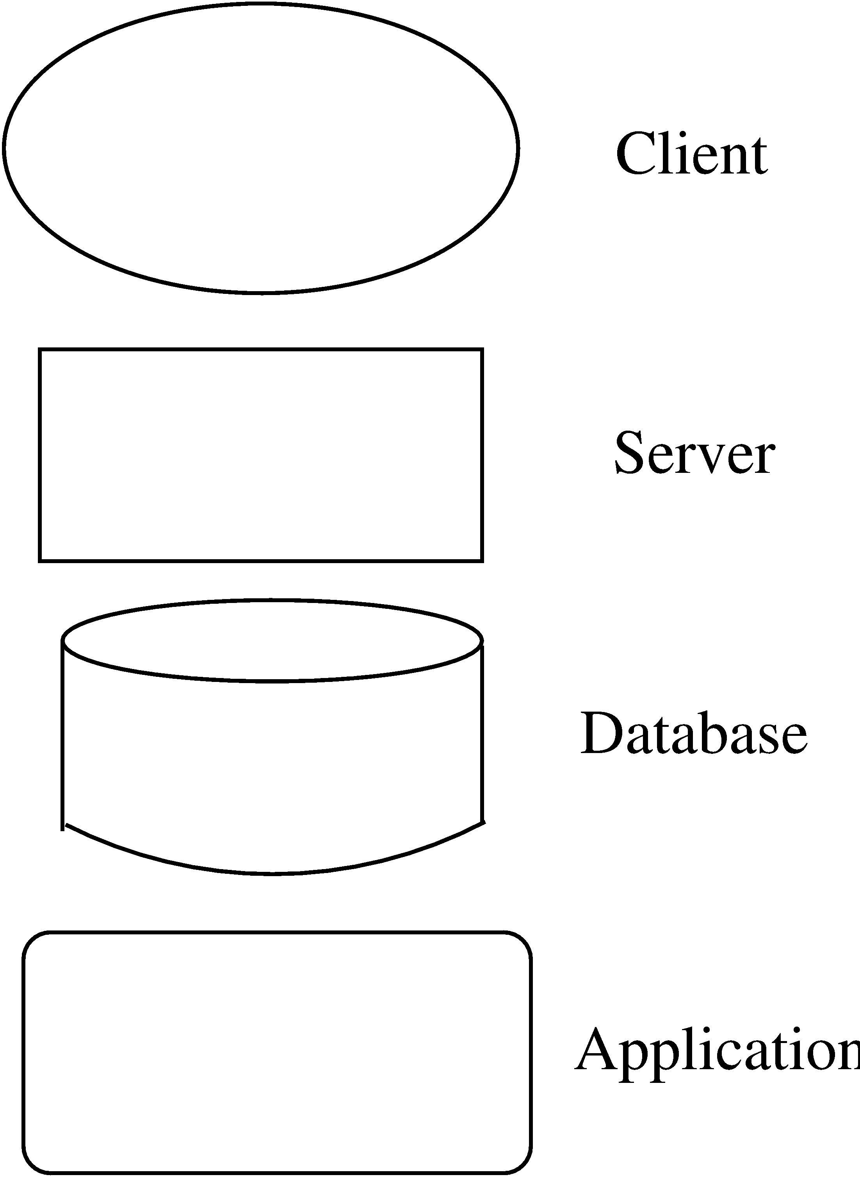
Some Component examples…
Software Architecture

Slide 19
Connectors
Interaction between components happen through connectors
A connector may be provided by the runtime environment, e.g. procedure call
But there may be complex mechanisms for interaction, e.g http, tcp/ip, ports,…; a lot of sw needed to support them
Important to identify them explicitly; also needed for programming comps properly
Software Architecture

Slide 20
Connectors…
Connectors need not be binary, e.g. a broadcast bus
Connector has a name (and a type)
Often connectors represented as protocol – i.e. comps need to follow some conventions when using the connector
Best to use diff notation for diff types of connectors; all connectors should not be shown by simple lines
Software Architecture

Slide 21
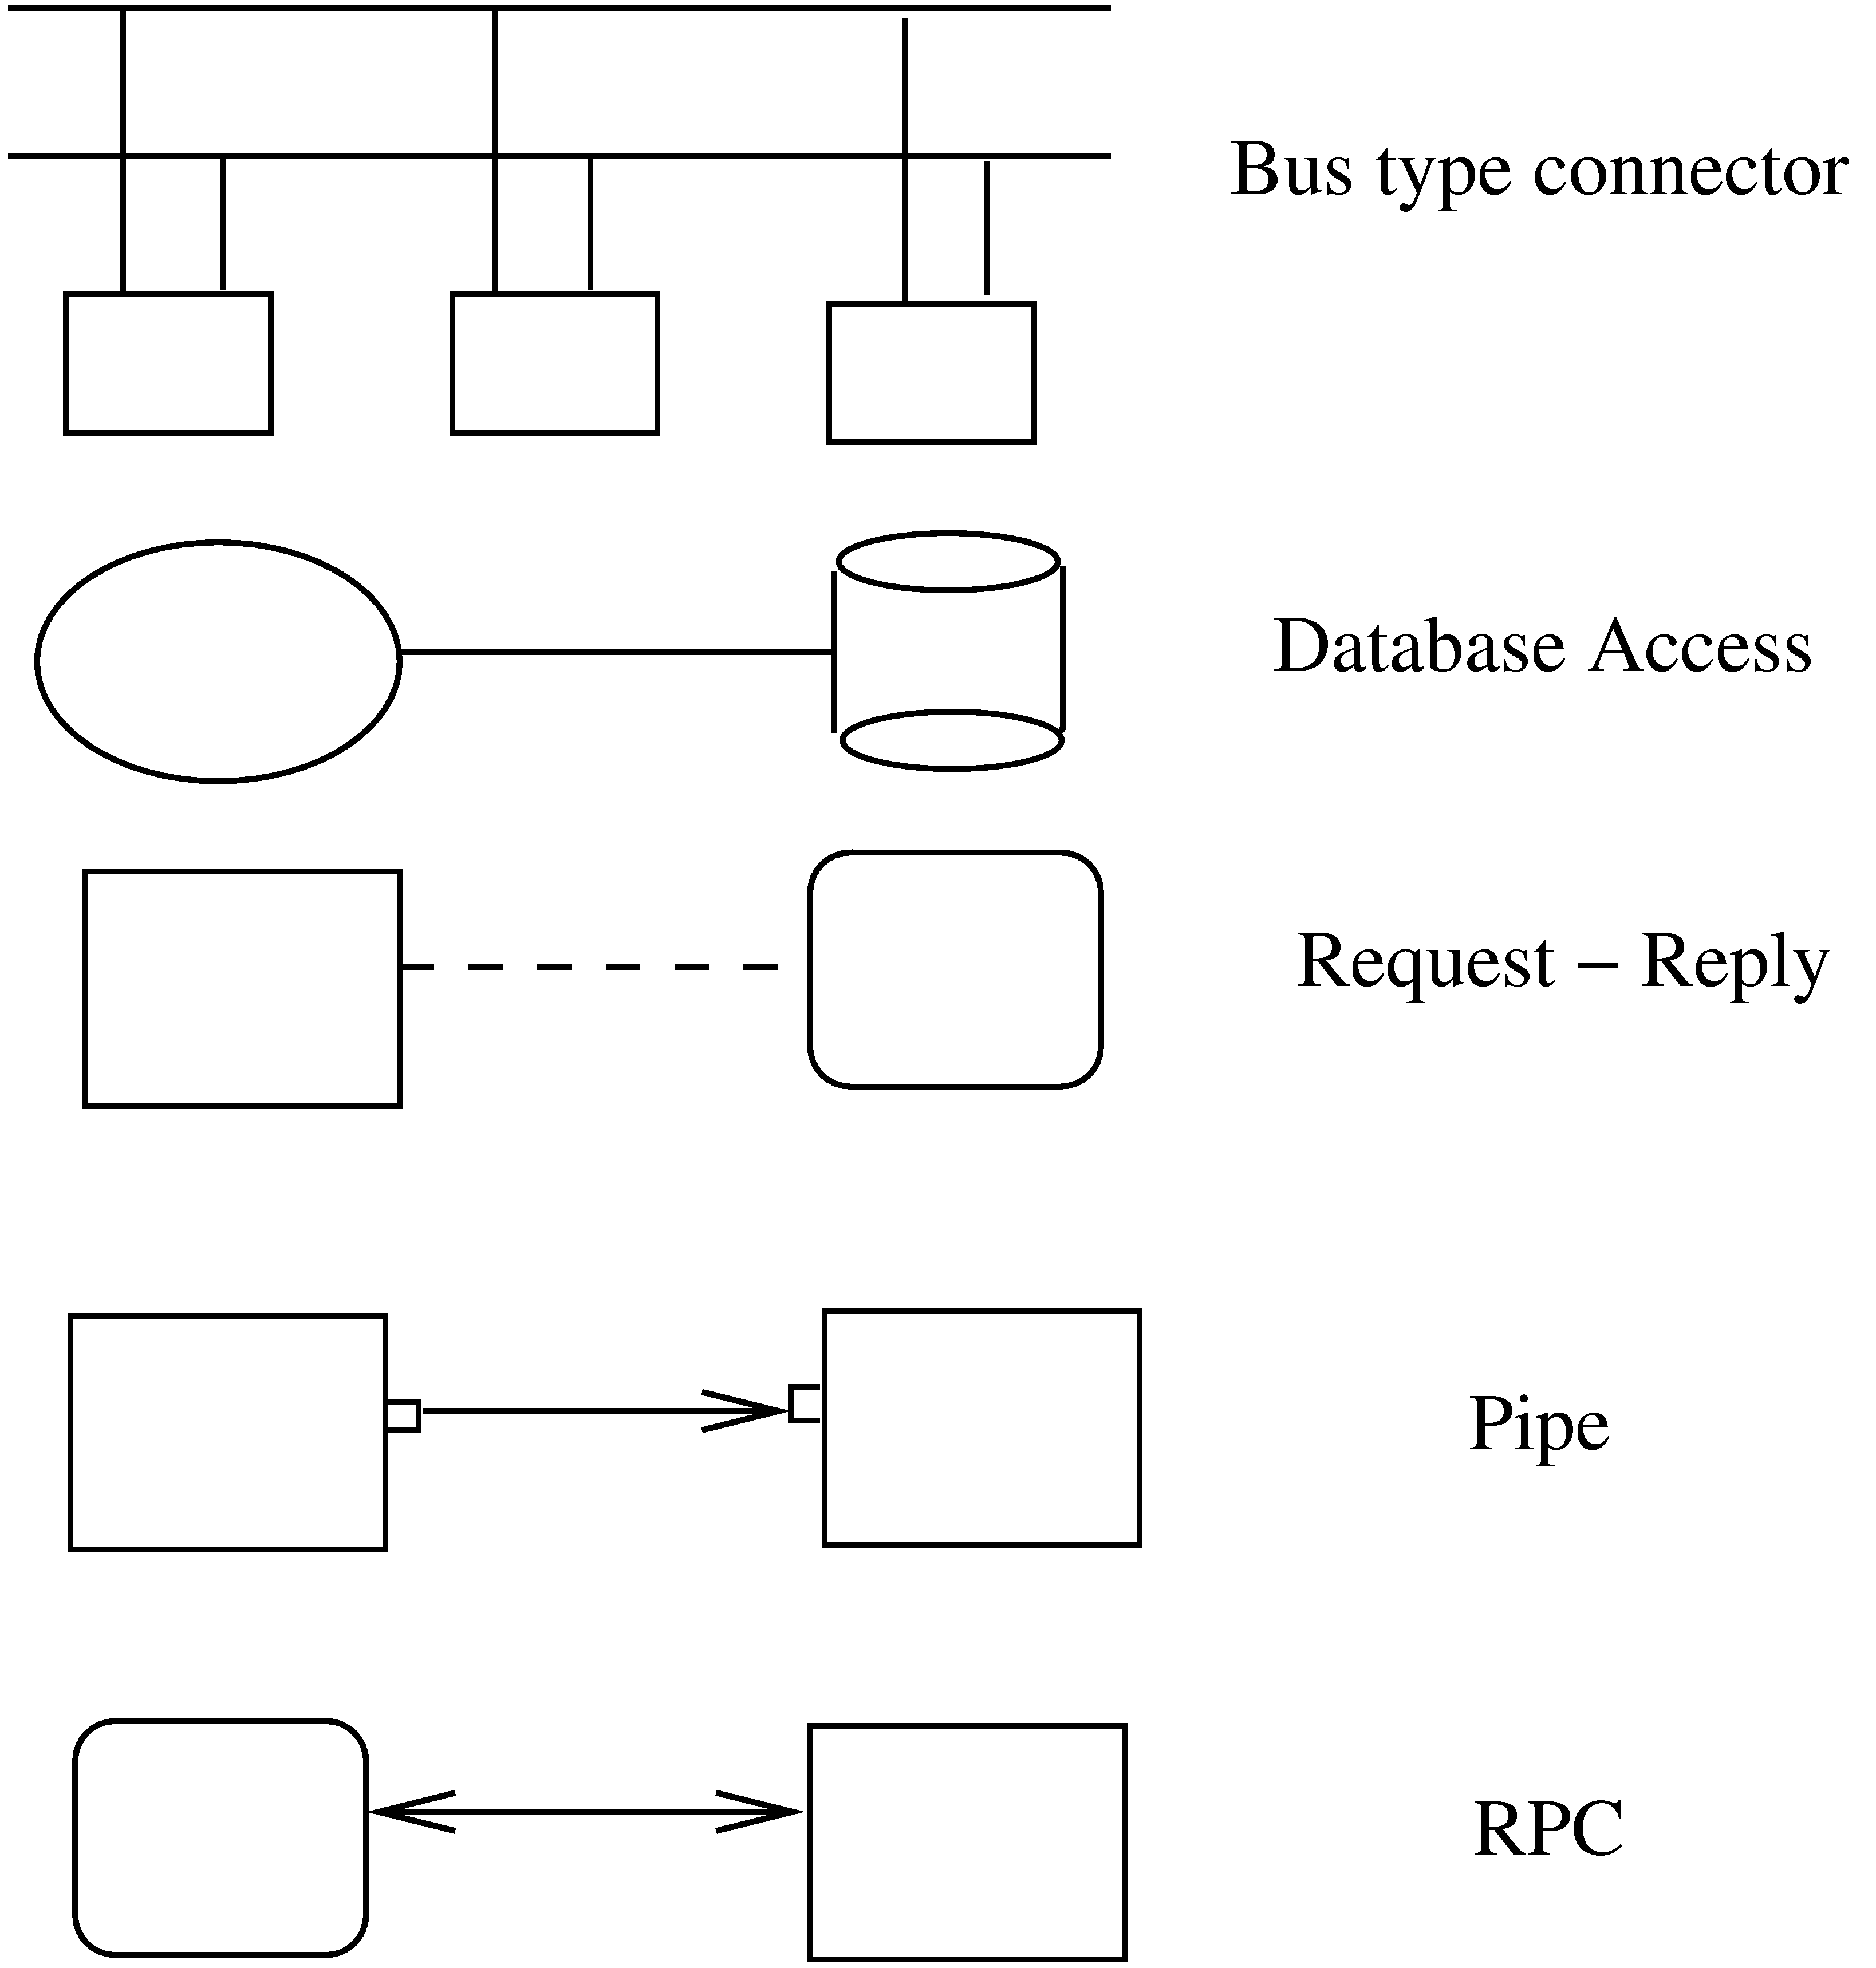
Connector examples
Software Architecture

Slide 22
An Example
Design a system for taking online survey of students on campus
  Multiple choice questions, students submit online
  When a student submits, current result of the survey is shown
Is best built using web; a 3-tier architecture is proposed
  Has a client, server, and a database components (each of a diff type)
  Connector between them are also of diff types
Software Architecture

Slide 23
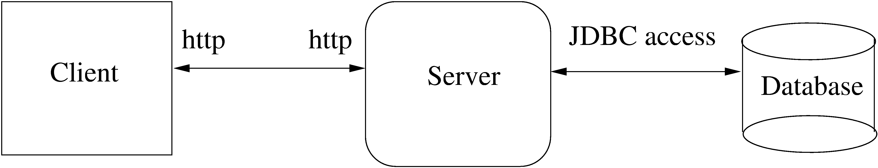
Example…
Software Architecture

Slide 24
Example…
At arch level, details are not needed
The connectors are explicitly stated, which implies that the infrastructure should provide http, browser, etc.
The choice of connectors imposes constraints on how the components are finally designed and built
Software Architecture

Slide 25
Extension 1
This arch has no security – anyone can take the survey
We want that only registered students can take the survey (at most once)
  To identify students and check for one-only submission, need a authentication server
  Need to use cookies, and server has to be built accordingly (the connector between server and auth server is http with cookies)
Software Architecture

Slide 26
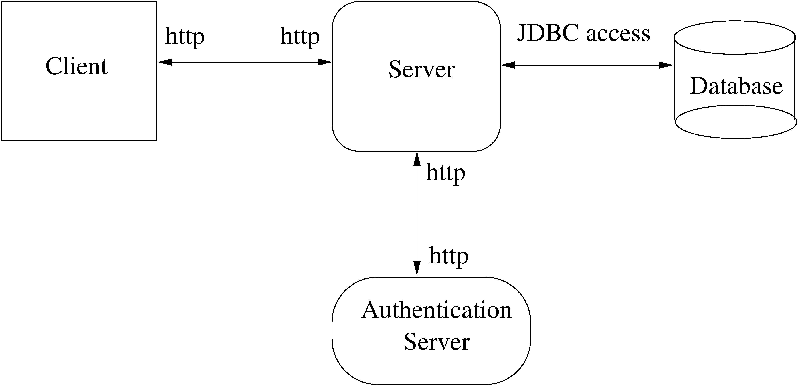
Extension 1…
Software Architecture

Slide 27
Extension 2
It was found that DB is frequently down
For improving reliability, want that if DB is down, student is given an older survey result and survey data stored
The survey data given can be outdated by at most 5 survey data points
For this, will add a cache comp, which will store data as well as results
Software Architecture

Slide 28
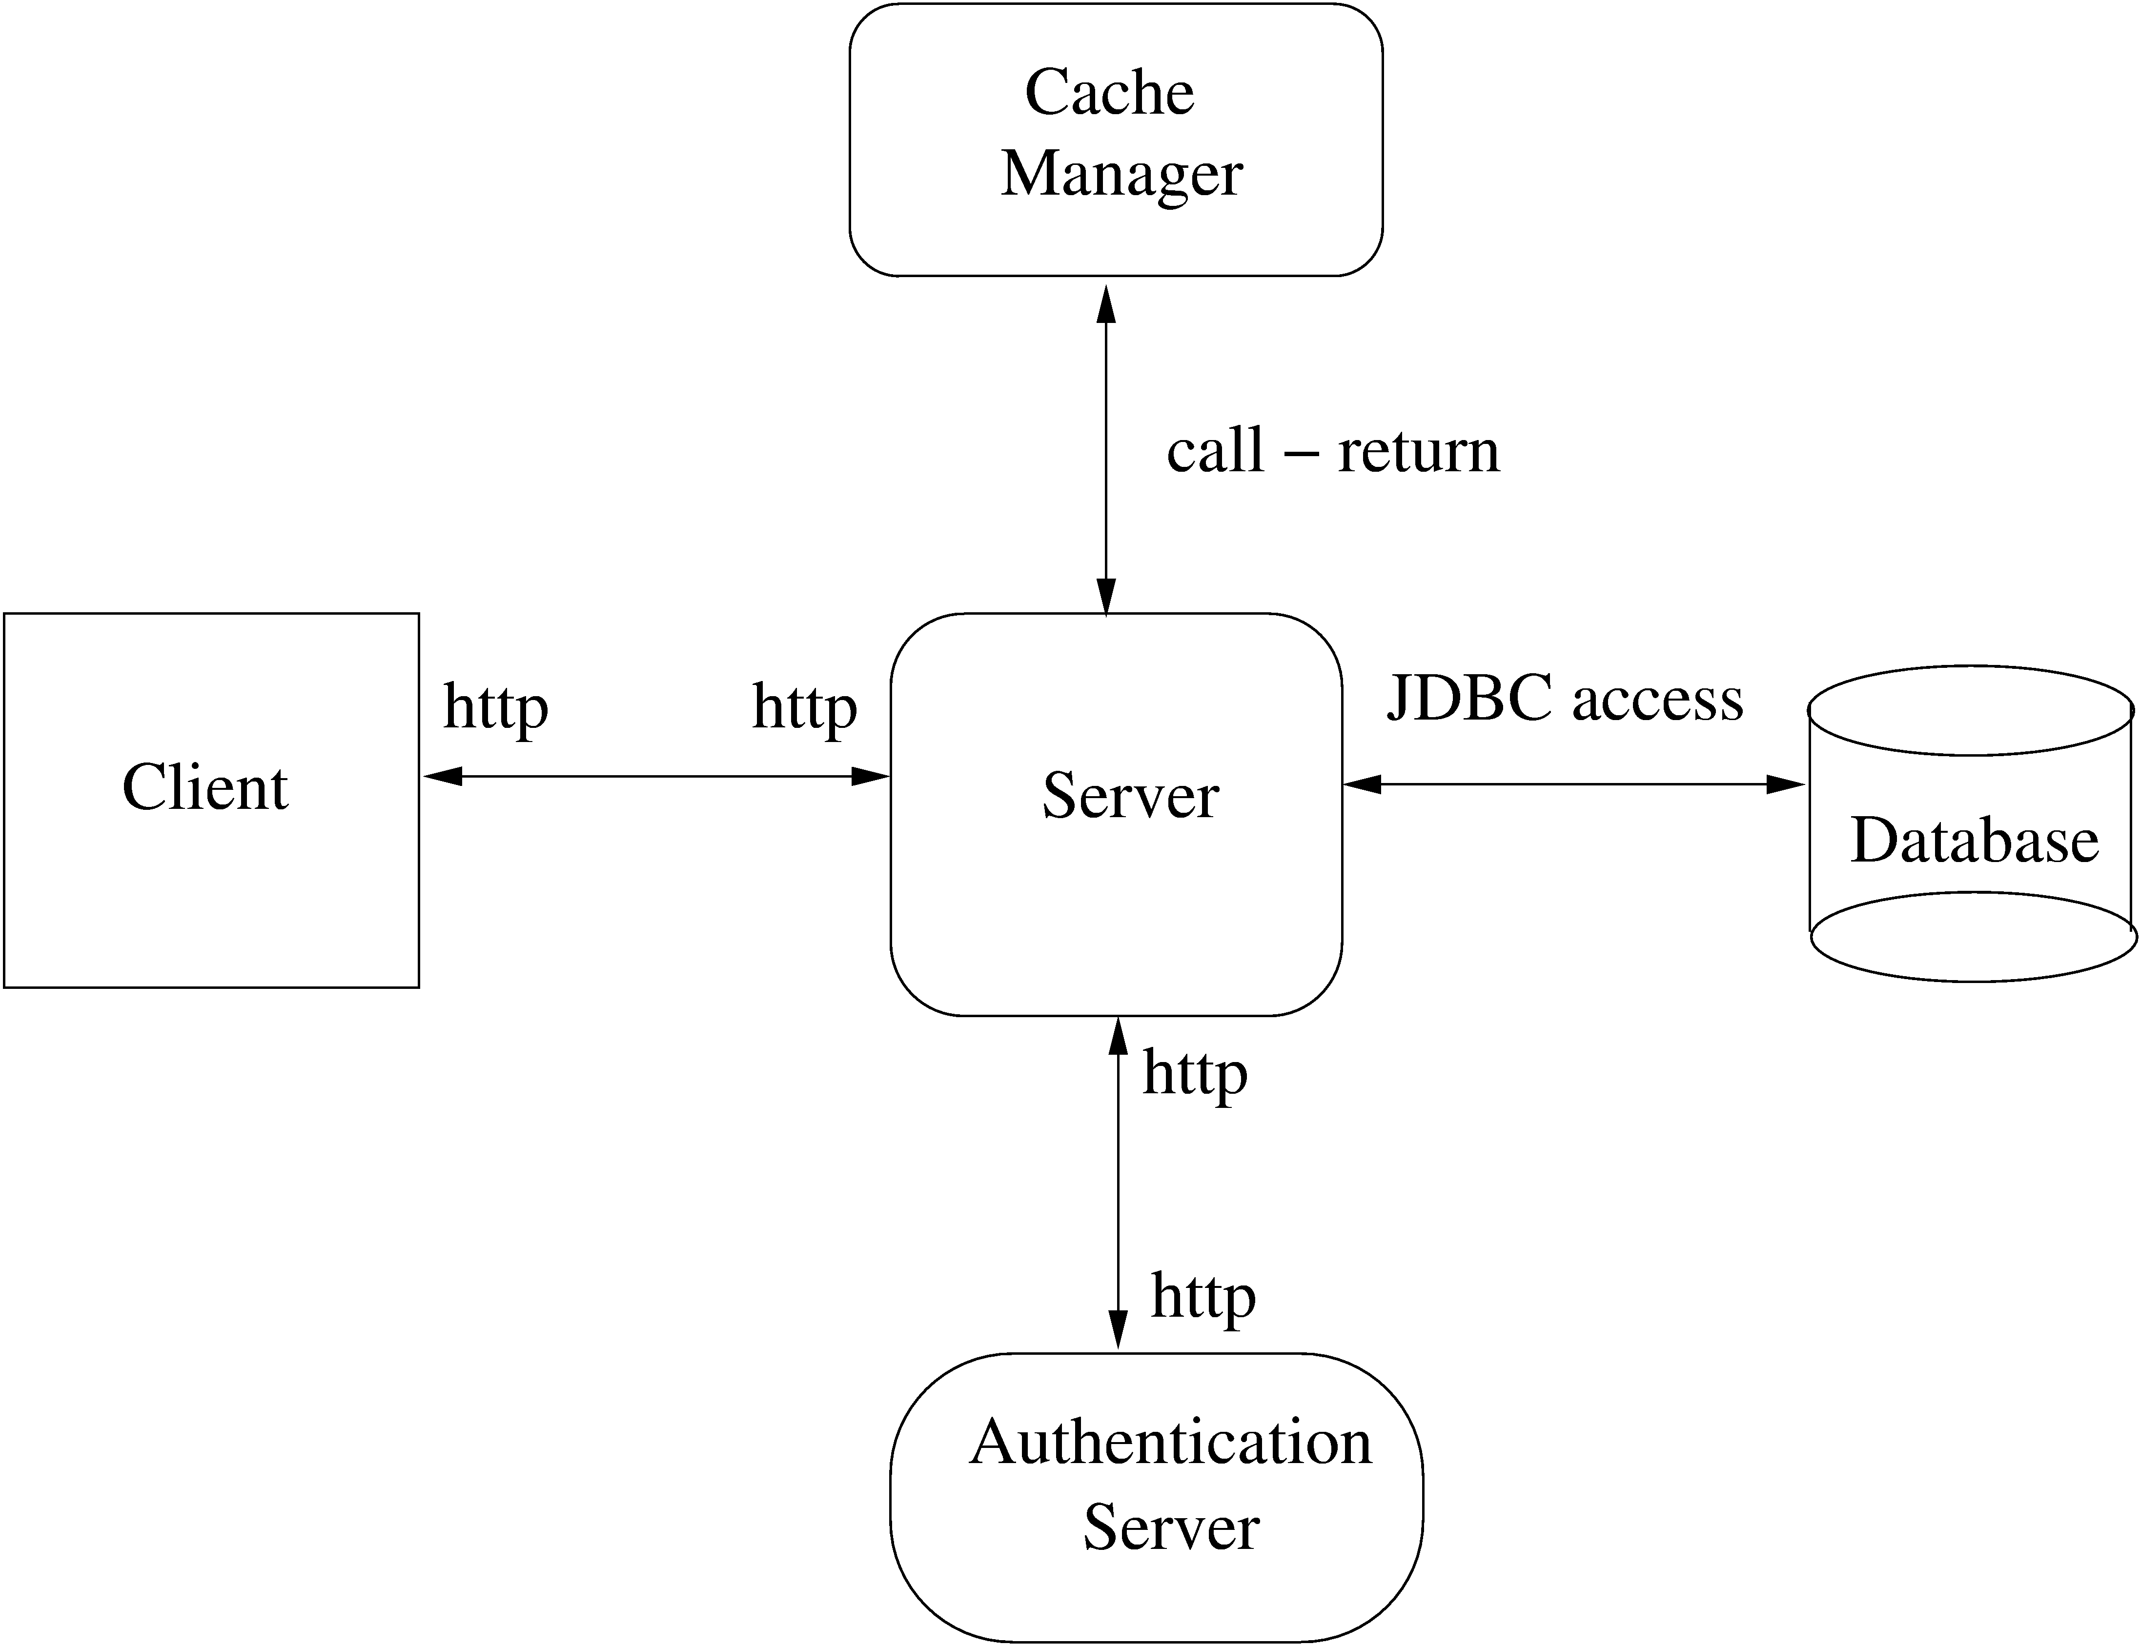
Extension 2…
Software Architecture

Slide 29
Example…
One change increased security, 2nd increased performance and reliability
I.e. Arch level choices have a big impact on system properties
That is why, choosing a suitable arch can help build a good system
Software Architecture

Slide 30
Architectural Styles for C&C View
Diff systems have diff C&C structure
Some structures are general and are useful for a class of problems – architectural styles
An arch style defines a family of archs that satisfy the constraint of that style
Styles can provide ideas for creating arch for a sys; they can be combined also
We discuss a few common styles
Software Architecture

Slide 31
Pipe and filter
Well suited for systems that mainly do data transformations
A system using this style uses a network of transforms to achieve the desired result
Has one component type – filter
Has one connector type – pipe
A filter does some transformation and passes data to other filters through pipes
Software Architecture

Slide 32
Pipe and Filter…
A filter is independent; need not know the id of filters sending/receiving data
Filters can be asynchronous and are producers or consumers of data
A pipe is unidirectional channel which moves streams of data from one filter to another
A pipe is a 2-way connector
Filters have to perform buffering, and synchronization between filters
Software Architecture

Slide 33
Pipe and filter…
Filters should work without knowing the identify of producers/consumers
A pipe must connect the output port of one filter to input port of another
Filters may have indep thread of control
Software Architecture

Slide 34
Example
A system needed to count the frequency of different words in a file
One approach: first split the file into a sequence of words, sort them, then count the #of occurrences
The arch of this system can naturally use the pipe and filter style
Software Architecture

Slide 35
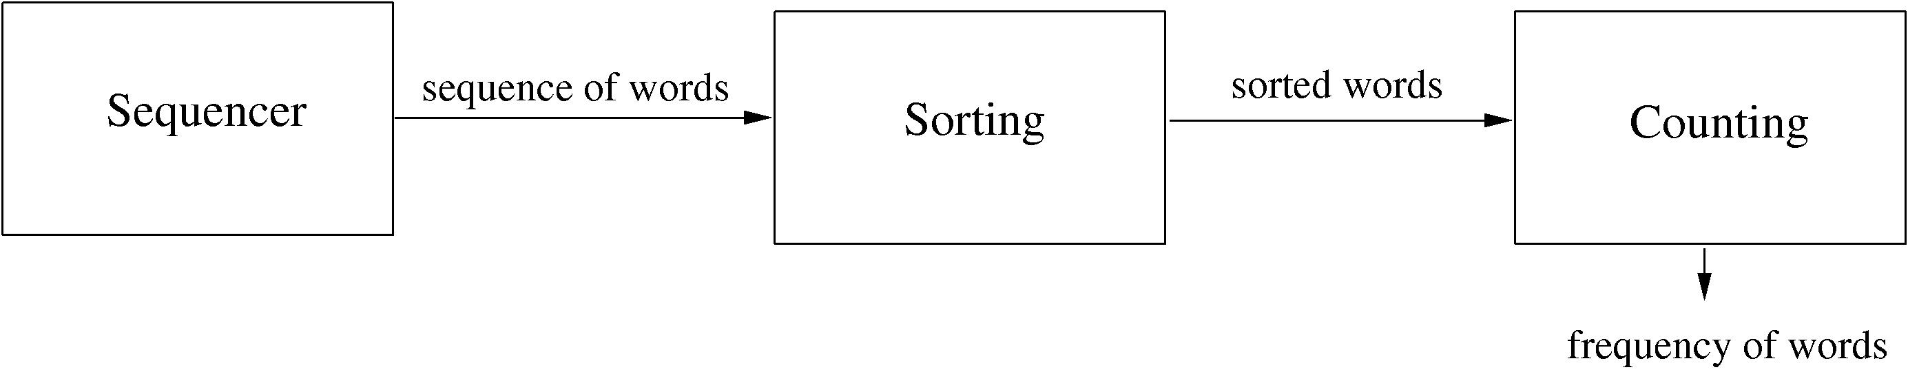
Example..
Software Architecture

Slide 36
Shared-data style
Two component types – data repository and data accessor
Data repository – provides reliable permanent storage
Data accessors – access data in repositories, perform computations, and may put the results back also
Communication between data accessors is only through the repository
Software Architecture

Slide 37
Shared-data style…
Two variations possible
  Black board style: if data is posted in a repository, all accessors are informed; i.e. shared data source is an active agent
  Repository style: passive repository
Eg. database oriented systems; web systems; programming environments,..
Software Architecture

Slide 38
Example
A student registration system of a university
Repository contains all the data about students, courses, schedules,…
Accessors like admin, approvals, registration, reports which perform operations on the data
Software Architecture

Slide 39
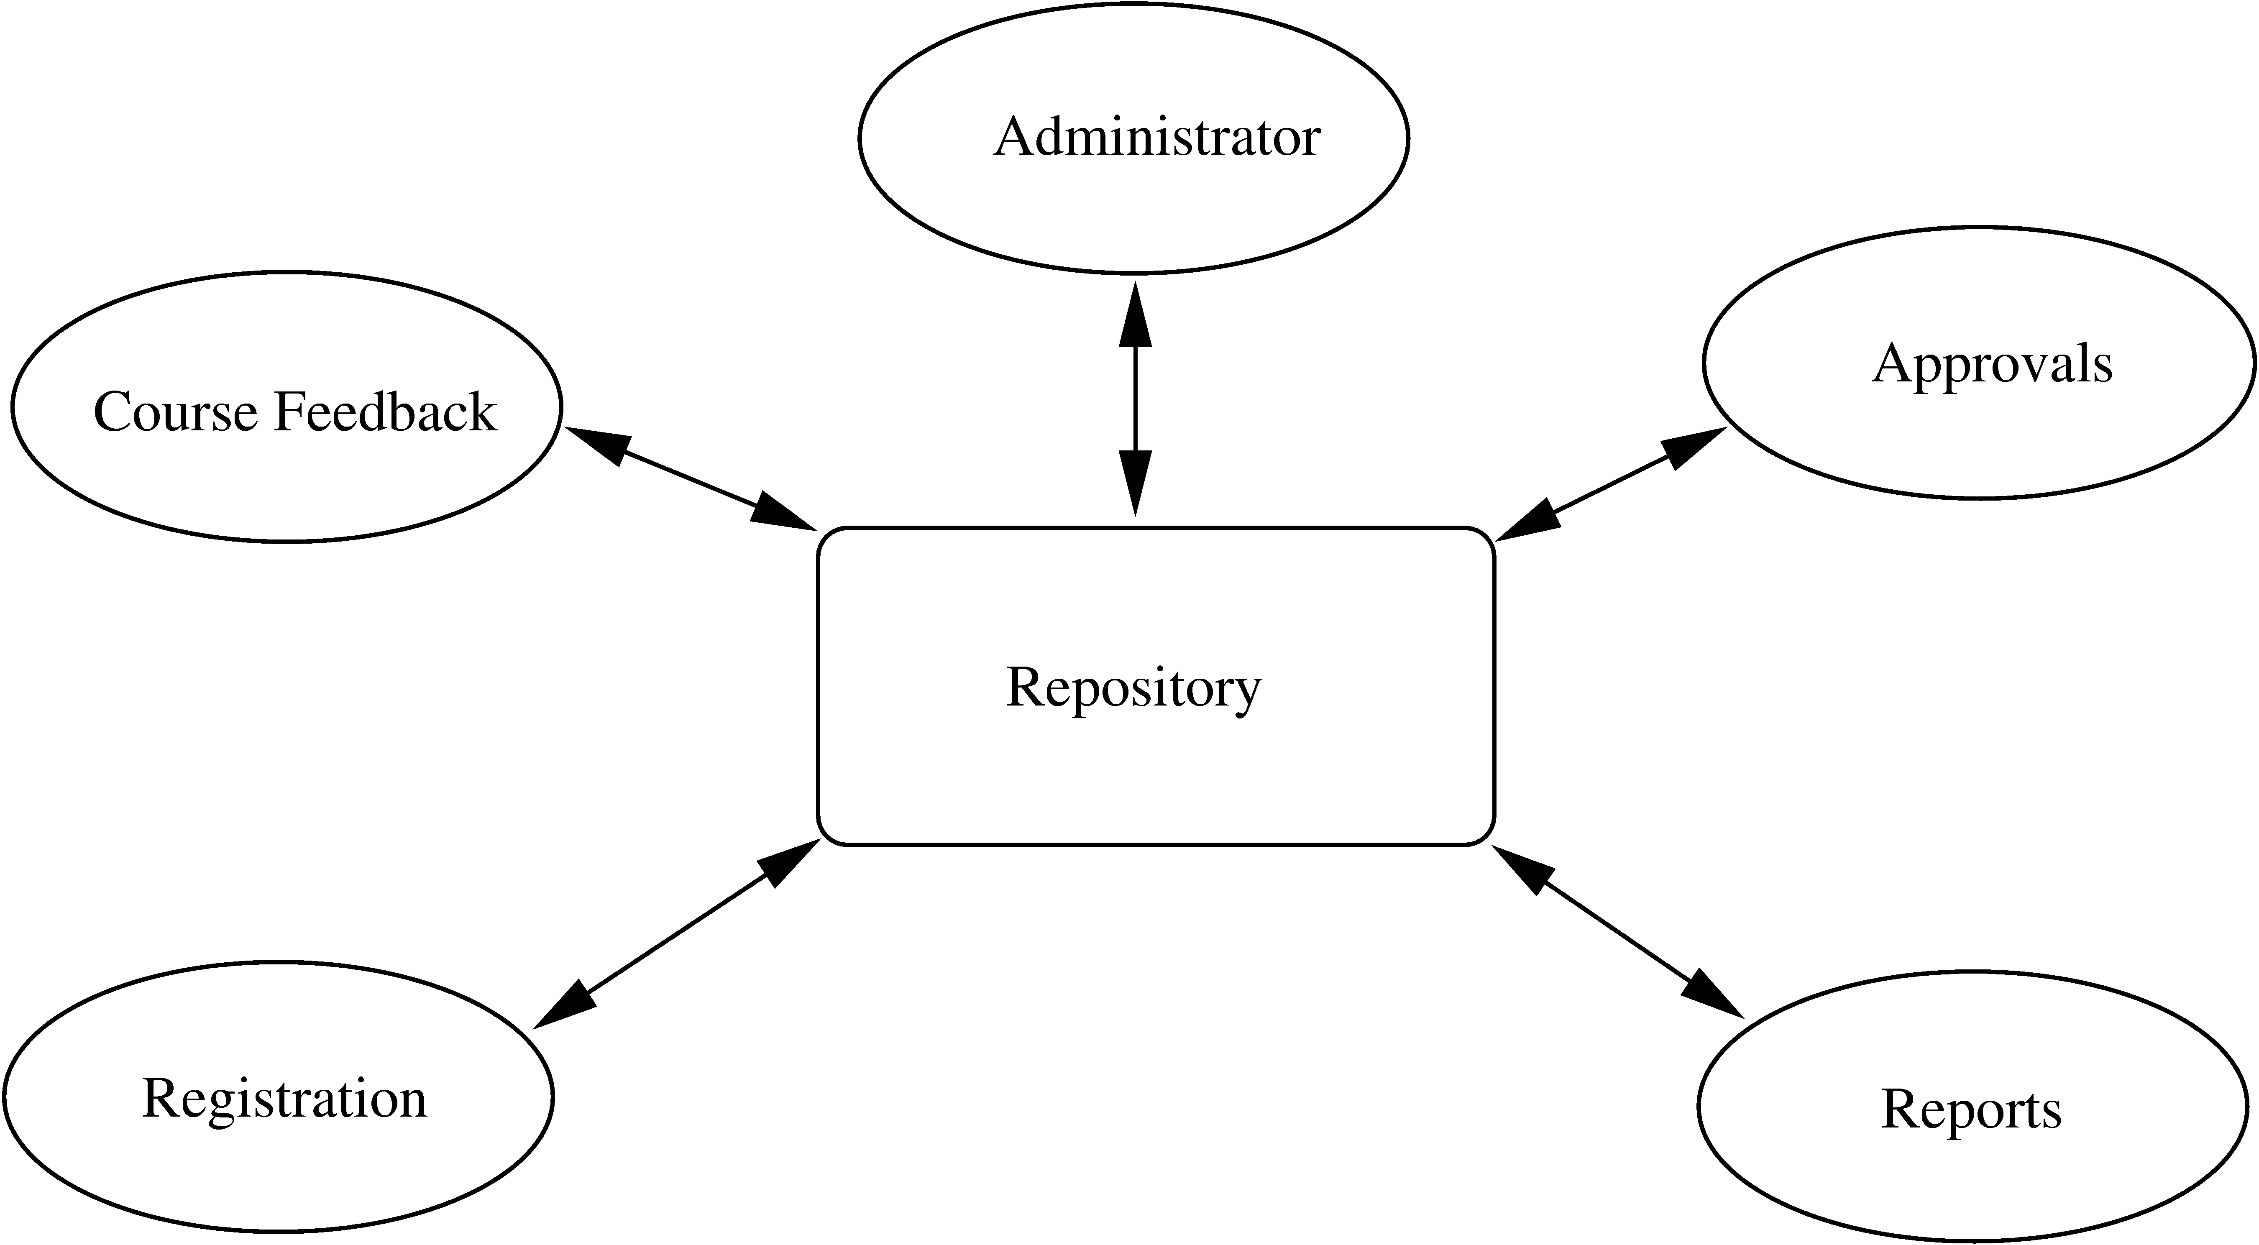
Example…
Software Architecture

Slide 40
Example..
Components do not directly communicate with each other
Easy to extend – if a scheduler is needed, it is added as a new accessor
  No existing component needs to be changed
Only one connector style in this – read/write
Software Architecture

Slide 41
Client-Server Style
Two component types – clients and servers
Clients can only communicate with the server, but not with other clients
Communication is initiated by a client which sends request and server responds
One connector type – request/reply, which is asymmetric
Often the client and the servers reside on different machines
Software Architecture

Slide 42
Client-server style…
A general form of this style is the n-tier structure
A 3-tier structure is commonly used by many application and web systems
  Client-tier contains the clients
  Middle-tier contains the business rules
  Database tier has the information
Software Architecture

Slide 43
Some other styles
Publish-subscribe style
  Some components generate events, and others subscribe to them
  On an event, those component that subscribe to it are invoked
Peer-to-peer style
  Like object oriented systems; components use services from each other through methods
Communication processes style
  Processes which execute and communicate with each other through message passing
Software Architecture

Slide 44
Architecture and Design
Both arch and design partition the system into parts and their org
What is the relationship between design and arch?
  Arch is a design; it is about the solution domain, and not problem domain
  Can view arch as a very high level design focusing on main components
  Design is about modules in these components that have to be coded
  Design can be considered as providing the module view of the system
Software Architecture

Slide 45
Contd…
Boundaries between architecture and design are not clear or hard
It is for designer and architect to decide where arch ends and design begins
In arch, issues like files, data structure etc are not considered, while they are important in design
Arch does impose constraints on design in that the design must be consistent with arch
Software Architecture

Slide 46
Preserving the Integrity of Architecture
What is the role of arch during the rest of the development process
Many designers and developers use it for understanding but nothing more
Arch imposes constraints; the implementation must preserve the arch
I.e. the arch of the final system should be same as the arch that was conceived
It is very easy to ignore the arch design and go ahead and do the development
Example – impl of the word frequency problem
Software Architecture

Slide 47
Example – arch 1
Implemented strictly as per the architecture
  Sequencing, sorting, and counting impl as separate processes
  Processes connected through the pipe command
Software Architecture

Slide 48
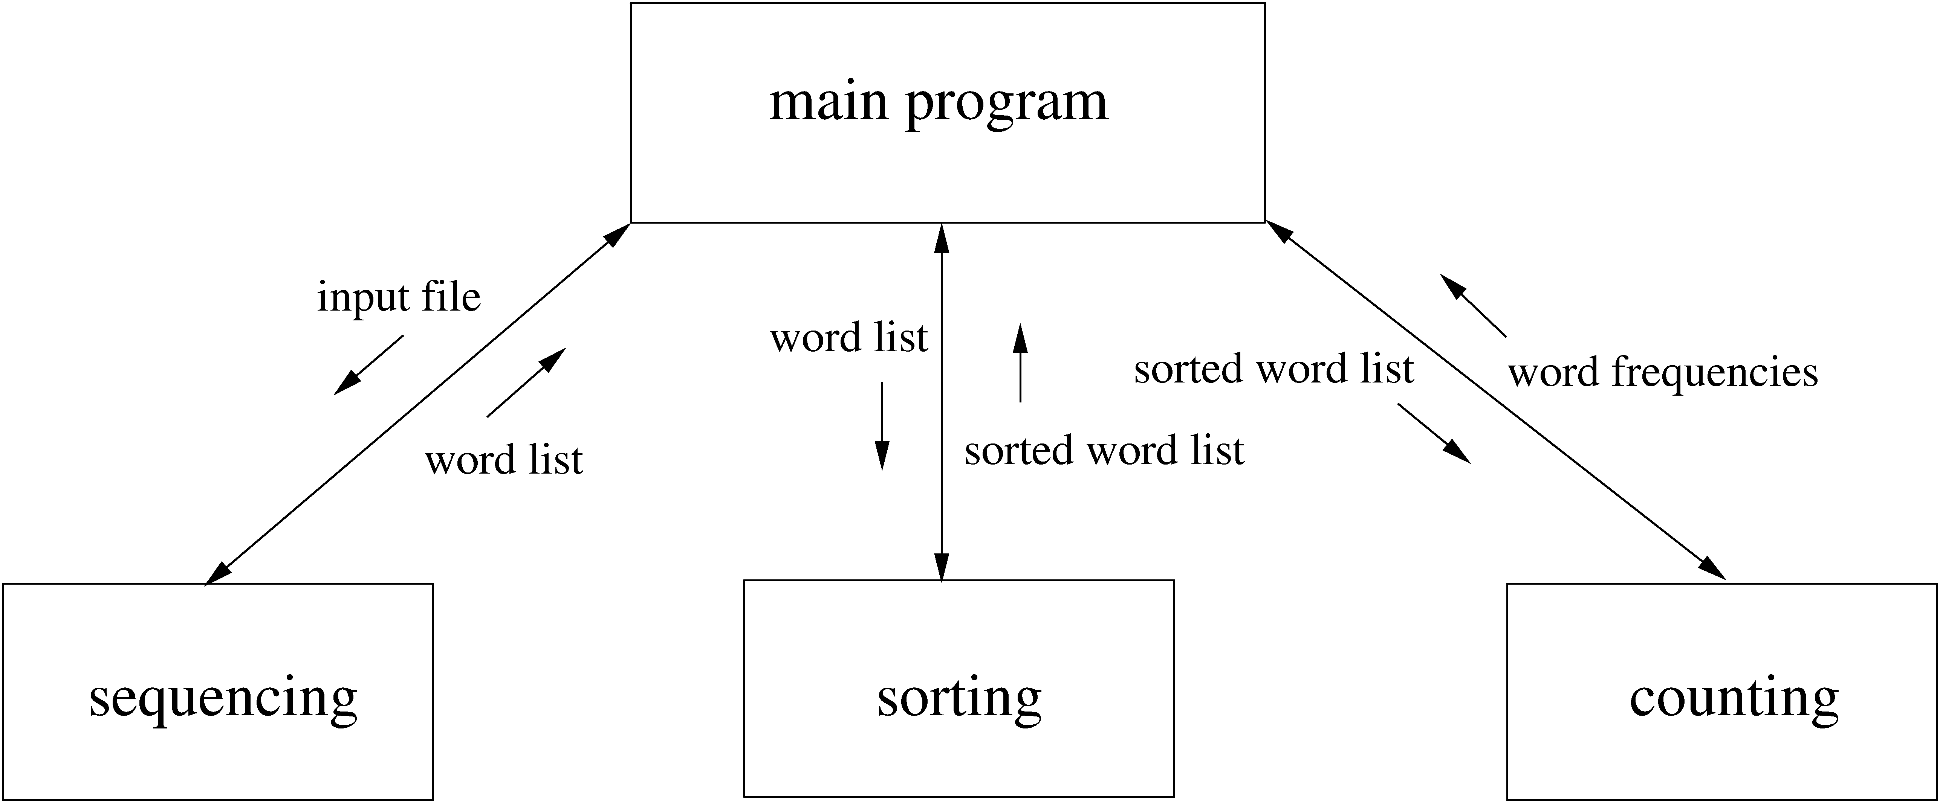
Example – arch 2
Software Architecture

Slide 49
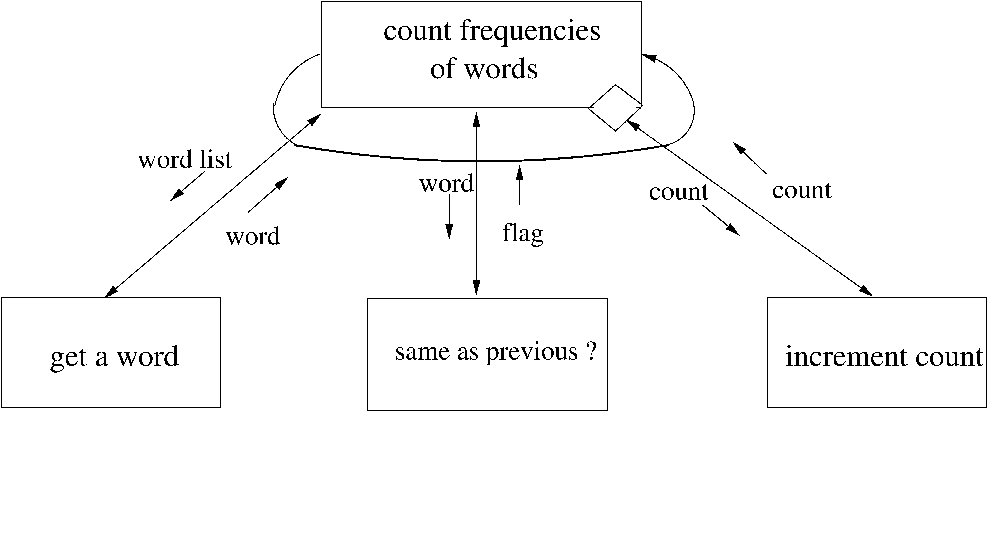
Example – arch 3
Software Architecture

Slide 50
Example…
First impl clearly preserves the arch
Second can also be considered as preserving the arch
The third ones does not preserve arch, even though it is a correct impl.
This type of mismatch, where the final arch of the sys is different from the one designed should be avoided
Software Architecture

Slide 51
Documenting Arch Design
While designing and brainstorming, diagrams are a good means
Diagrams are not sufficient for documenting arch design
An arch design document will need to precisely specify the views, and the relationship between them
Software Architecture

Slide 52
Documenting…
An arch document should contain
  System and architecture context
  Description of architecture views
  Across view documentation
A context diagram that establishes the sys scope, key actors, and data sources/sinks can provide the overall context
A view description will generally have a pictorial representation, as discussed earlier
Software Architecture

Slide 53
Documenting…
Pictures should be supported by
  Element catalog: Info about behavior, interfaces of the elements in the arch
  Architectural rationale: Reasons for making the choices that were made
  Behavior: Of the system in different scenarios (e.g. collaboration diagram)
  Other Information: Decisions which are to be taken, choices still to be made,..
Software Architecture

Slide 54
Documenting…
Inter-view documentation
  Views are related, but the relationship is not clear in the view
  This part of the doc describes how the views are related (eg. How modules are related to components)
  Rationale for choosing the views
  Any info that cuts across views
Sometimes views may be combined in one diagram for this – should be done if the resulting diagram is still easy to understand
Software Architecture

Slide 55
Evaluating Architectures
Arch impacts non-functional attributes like modifiability, performance, reliability, portability, etc
  Attr. like usability etc are not impacted
Arch plays a much bigger impact on these than later decisions
So should evaluate a proposed arch for these properties
Q: How should this evaluation be done?
  Many different ways, we briefly discuss ATAM
Software Architecture

Slide 56
ATAM analysis method
Analyzes some properties and tradeoffs between them; Main steps
  Collect Scenarios.
  Collect Requirements or Constraints.
  Describe architectural views.
  Attribute-specific analysis.
  Identify sensitivity and tradeoffs
Software Architecture

Slide 57
ATAM…
Collect Scenarios
  Scenarios describe interactions
  For analysis we should pick key scenarios of interest for which analysis will be done; important exception scenarios should be included
Collect requirements or constraints
  Define what is expected from the system in these scenarios
  They should specify the desired levels for the attributes of interest
Software Architecture

Slide 58
ATAM…
Describe architectural views
  The views of the system that will be evaluated are collected
  Diff views may be needed for diff types of analyses
Attribute specific analysis
  The views under diff scenarios are analyzed for diff quality attributes separately
  Provides levels that the arch can provide
  Becomes basis of selecting arch
  Any modeling or technique can be used
Identify sensitivities and tradeoffs
  Tradeoff analysis
Software Architecture

Slide 59
An Example
The student-survey system, the arch with the cache
For analysis, we add the cache between the database and server
  Diff from having a separate cache
Software Architecture

Slide 60
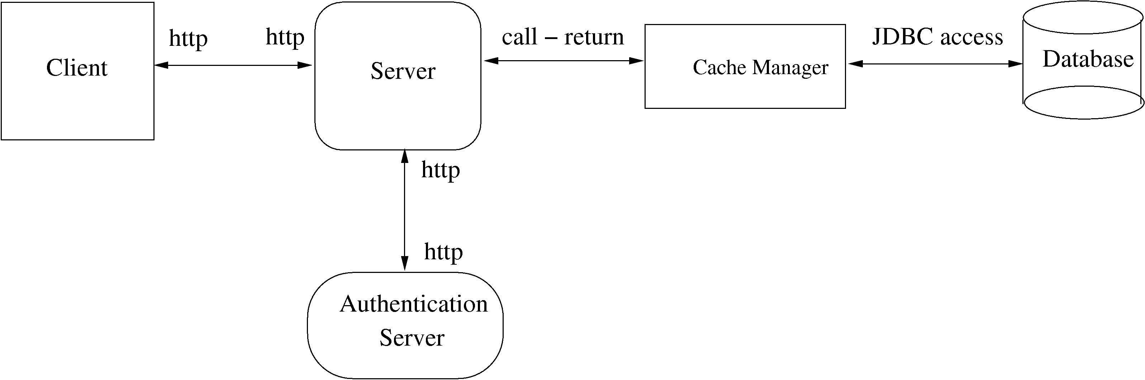
Example…
Software Architecture

Slide 61
Example – scenarios of interest
S1: A student submits the survey form and gets current results (normal scenario; all servers are up, load normal)
S2: A student tries to take the survey many times
S3: The database server is temporarily down
S4: The network/system is highly loaded
Software Architecture

Slide 62
Example – Sys req or constraints
Security. A student should be allowed to take the survey at most once
Response Time. A student should get a response time of less than 2 sec on an average, 80% of the time
Availability. The system should at least have availability of 0.85
Data Currency. The survey result given to a student should not be older than 5 submissions before
Software Architecture

Slide 63
Example – analysis
We evaluate the three architecture proposals
We will consider each attribute and study each arch under scenarios where it is relevant
For security and data currency – subjective evaluation based on understanding
For availability and response time – simple model based analysis done
Software Architecture

Slide 64
Example – availability
Assume avail of each machine is 0.9; while db is down 10 reqs come
Resp times (for normal, heavily loaded):
  Server 300ms 600ms
  Database 800ms 1600ms
  Cache 50ms 50ms
Timeout of 2 sec
Network heavily loaded 1% of the time
Software Architecture

Slide 65
Example – availability..
Avail for first arch is the prob that both servers and db are up, i.e. .9*.9=0.81
Avail of 2nd and 3rd - when db down still half reqs are serviced by cache
  Extra Avail: 0.5*0.9*0.1=0.045
  Total avail: 0.81+0.045 = 0.855
Software Architecture

Slide 66
Example – resp time
For arch 1, under normal load: 300+800
For arch 2: 300+800+50 (normal)
  When db down: 300+2000+50= 2350
For arch 3 (normal): 350*0.8 (for those serviced by cache) + 1350*0.2 (for those that go to db)
  Avg: 550 ms (normal)
  When db down: same for requests that are serviced
Software Architecture

Slide 67
Example – eval summary
 | Arch 1 | Arch 2 | Arch 3
Security(S1,S2) | Yes | Yes | Yes
Resp time (S1) Resp time (S3) Respt time (S4) | 1100 N/A 2200 | 1150 2350 2300 | 550 550 1100
Availability (S3) | 0.81 | 0.855 | 0.855
Data currency (S1) Data currency (S2) | Yes N/A | Yes Yes | Yes Yes
Software Architecture

Slide 68
Example – Eval summary…
Security and data currency requirements are satisfied by all three architecture options
Resp time req is also met by all as it is less than 2 sec in normal scenario, whose prob is 0.8
Availability is met by the second and third options only (third is preferred as it has a smaller response time)
Software Architecture

Slide 69
Summary
Arch of a sw system is its structures comprising of elements, their external properties, and relationships
Arch is a high level design
Three main view types – module, component and connector, and allocation
Component and connector (C&C) view is most commonly used
Software Architecture

Slide 70
Summary…
There are some C&C styles that are commonly used, e.g. pipe-and-filter, shared data, client server,....
An arch description should document the different views and their relationship – views can be combined
Rationale and other supporting information should also be captured
Software Architecture

Slide 71
Summary…
Arch can be analyzed for various non-functional attributes like performance, reliability, security, etc
ATAM is one approach for analyzing architectures, which evaluates attributes of interest under different scenarios
Software Architecture

